Slide 1
Open Science Discussion
Cole Brookson & Alex Davis
01 November 2021

Slide 2
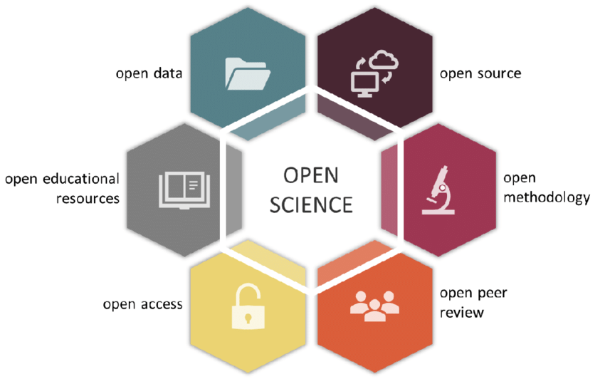
What is “Open Science”?

Slide 3
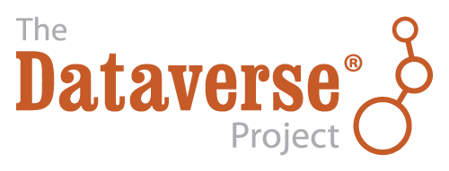

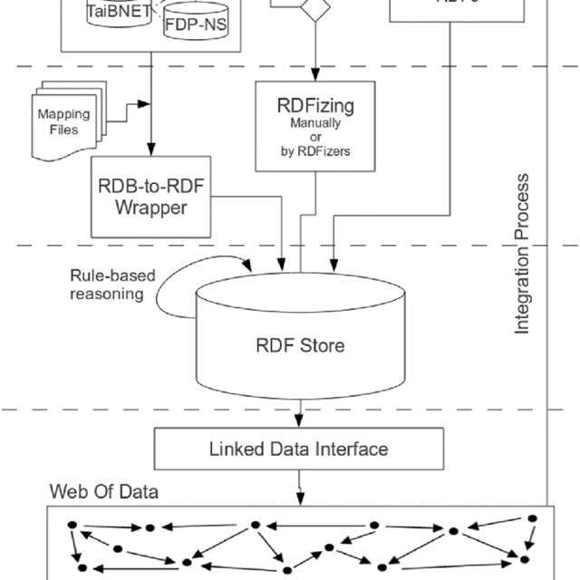
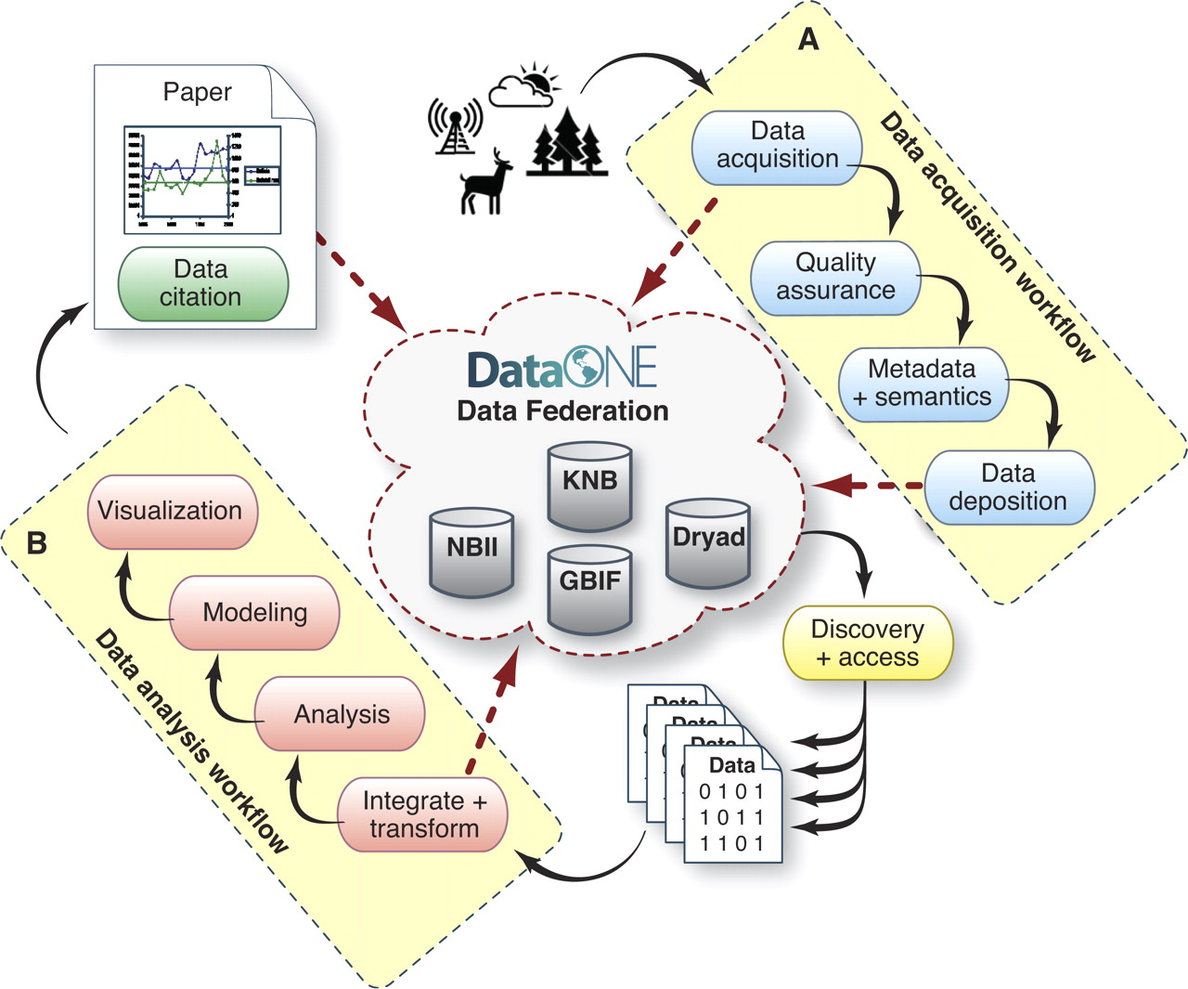
Open Data

Slide 4

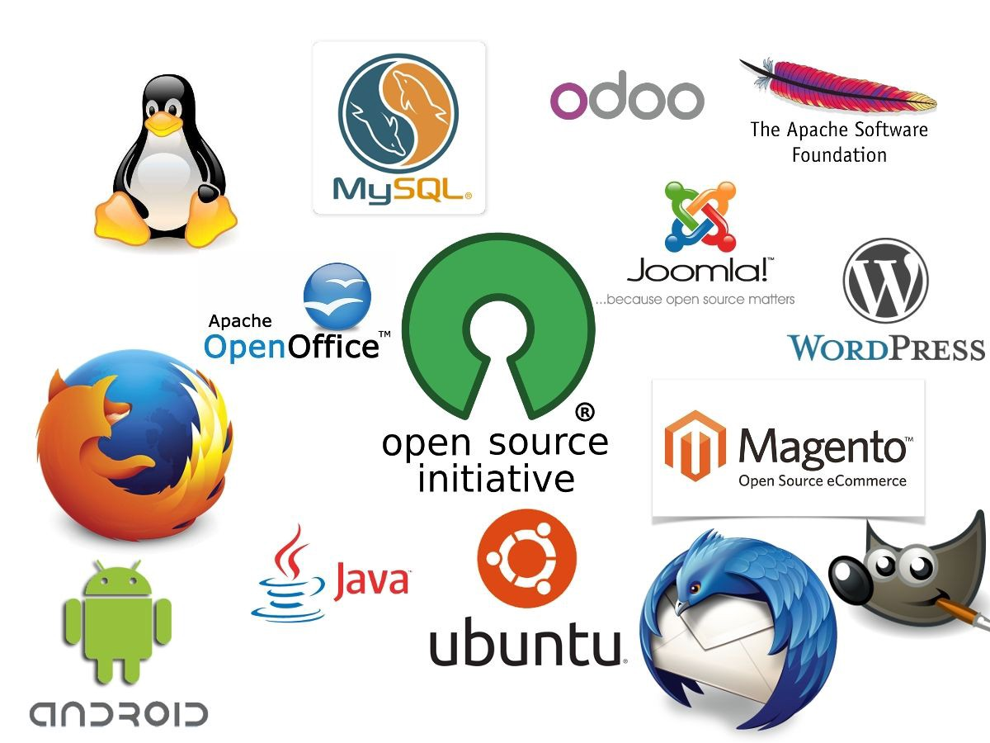
Open Source
“open source”: denoting software for which the original source code is made freely available and may be redistributed and modified.

Slide 5
Why Open Source?
“Given enough eyes, all bugs are shallow”
-Linus’ Law

Slide 6
Why Open Source?
“Given enough eyes, all bugs are shallow”
-Linus’ Law

Slide 7
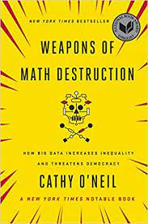
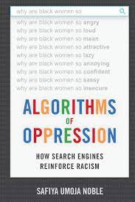
Why Open Source?
“Given enough eyes, all bugs are shallow”
-Linus’ Law
Allows for increased transparency in analysis
More flexible software
Helps address oppressive methods
Addresses reproducibility crisis

Slide 8




Open Methodology
Possibly the most important one!!

Slide 9

Open Methodology
Possibly the most important one!!

Slide 10
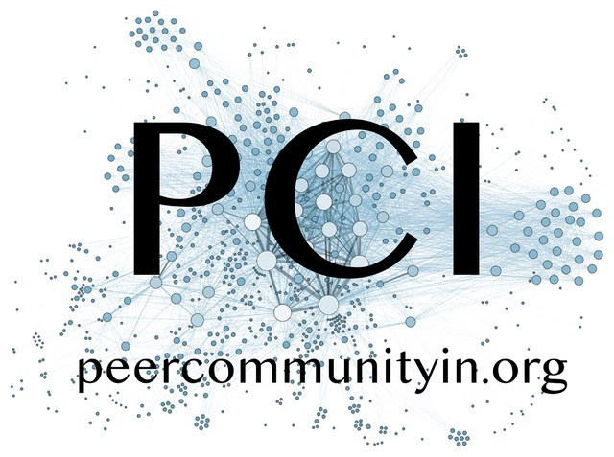
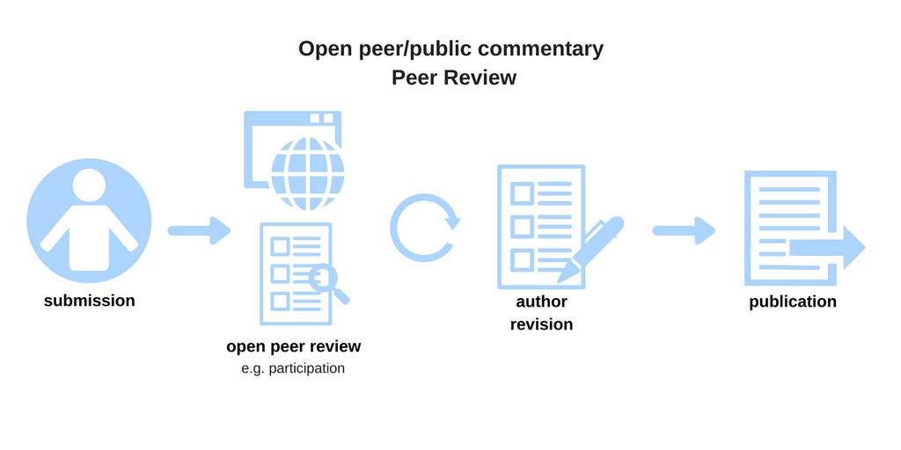
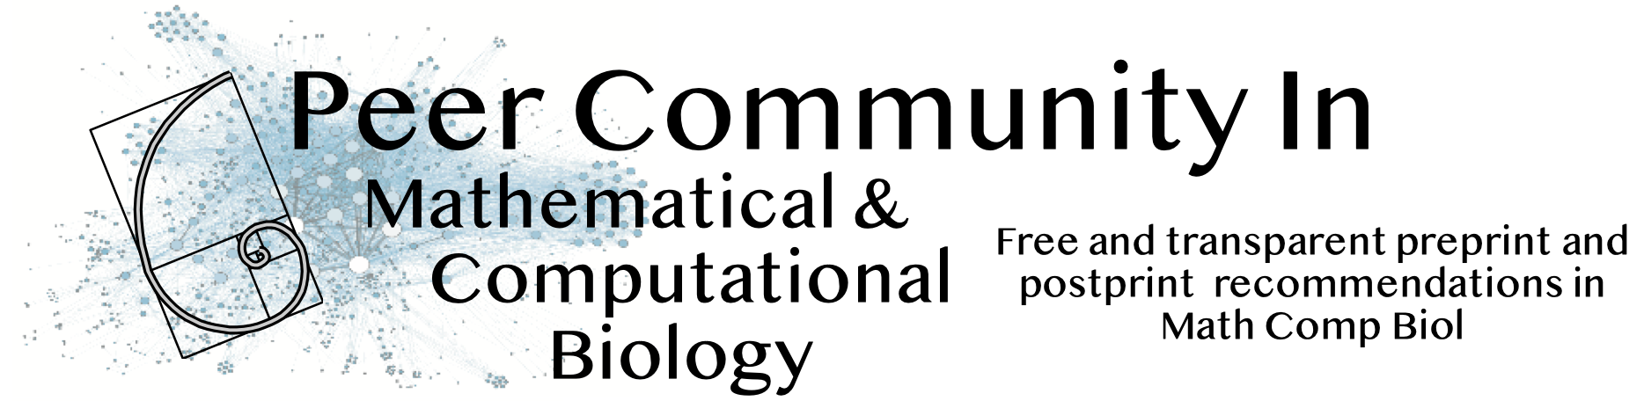
Open Peer Review

Slide 11



Open Access
Open Access returns us to the values of science: to help advance and improve society. By providing immediate and unrestricted access to the latest research, we can accelerate discovery and create a more equitable system of knowledge that is open to all

Slide 12
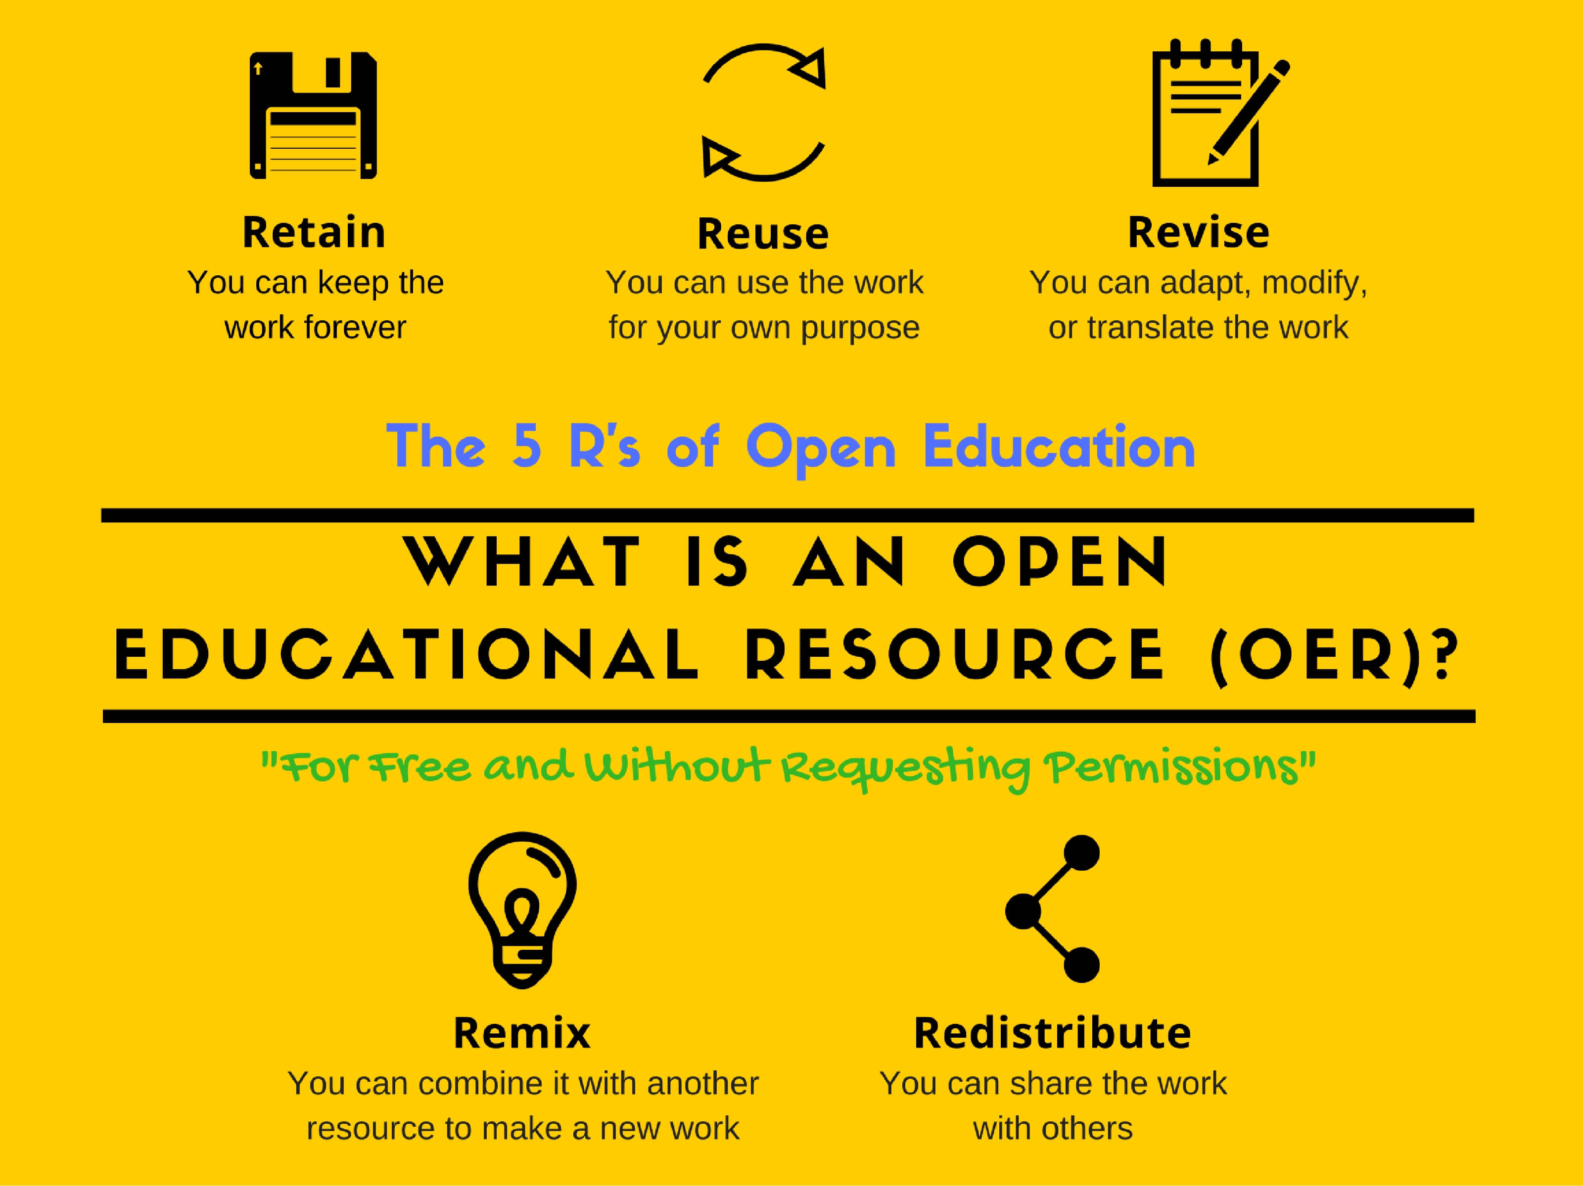
Open Education

Slide 13
Hard Questions
1. Who owns & has rights to data that were expensive to collect and possibly unique (i.e. long-term field projects?)
2. How much is “enough” in regards to best practices with regards to methods?
3. Who pays for all this?
4. ?

